Slide 1
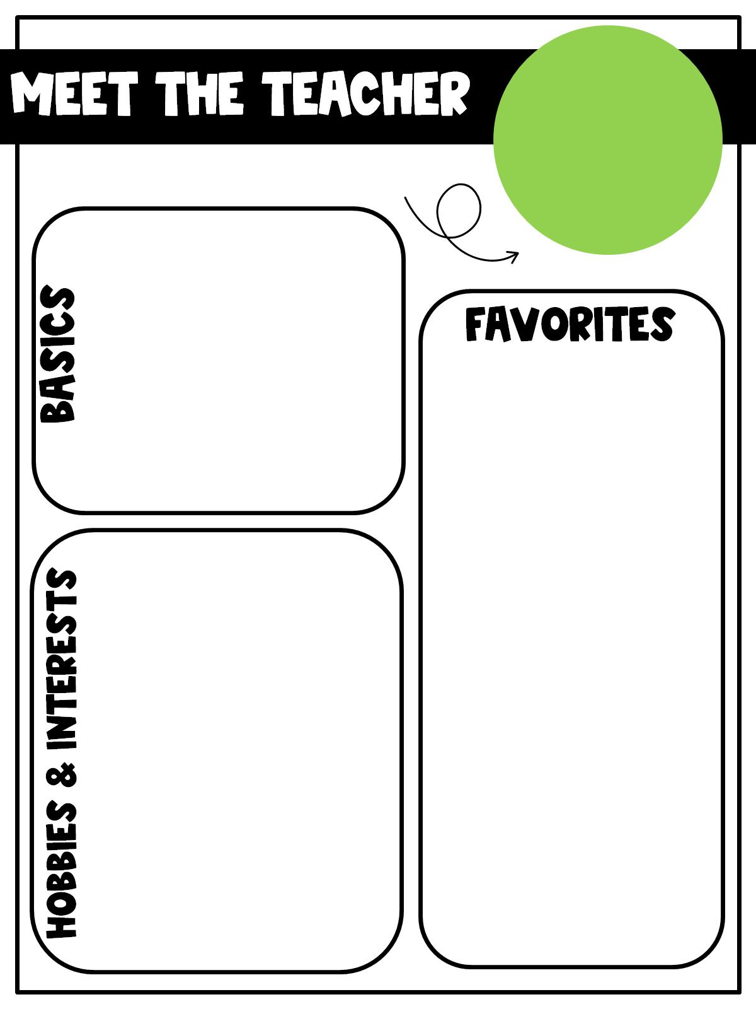
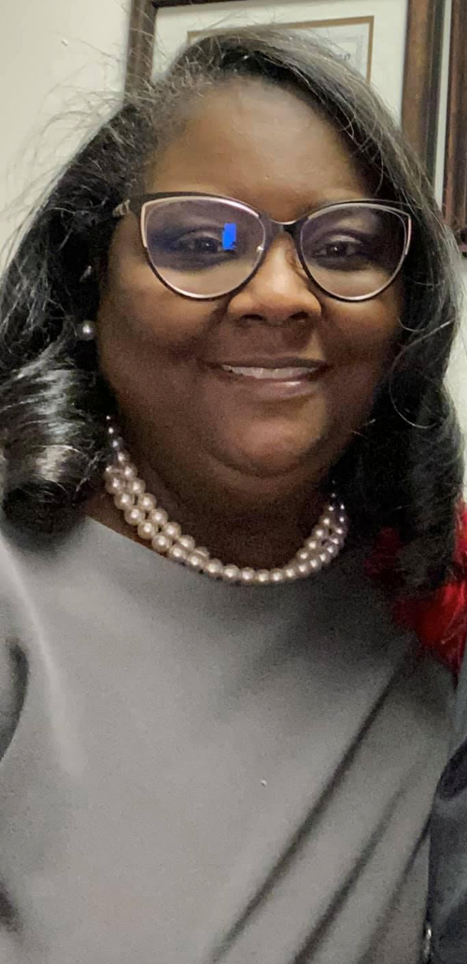
Meet the Media Specialist
Hi, I’m Mrs. Rollins
I am married to my friend, who I like a lot, Carl. We’ve been married for 27 years! We have three grown-ups & several grands, the youngest of the bunch we call Button. have been teaching for over 23 years.
My birthday is Jan. 5th ☺
School Supply-Pilot Pen
Color-Green/Blue
Coffee-Starbucks
Place to Shop- Dillard's
Fast-food--Chick-fila ☺
Candles-Bath & Body
Scents-Clean-linen
Candy-Kit-Kats ☺
Salty-Sea-Salt Almonds
Crunchy snack-Lays Chips
Fruit-Dried Pineapple
Sit & Eat- Road House
Drinks-Ginger Ale
Online shop- AMAZON ☺
Teaching others
Attending Church
Spoiling my grands☺
Traveling
Buying for others
Movie/Date Night☺
Relaxing (husband’s recliner)
Playing Chess
Card games ☺

